Slide 1
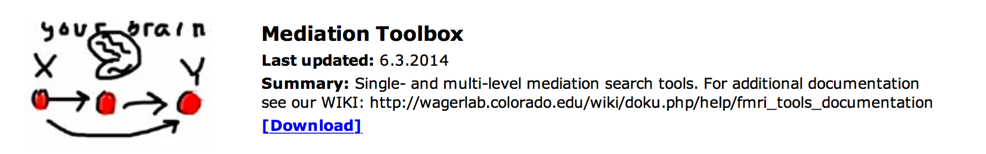
Single-level mediation effect parametric mapping in fMRI
Wagerlab.colorado.edu
Walkthrough for setup of sample data
Tor D. Wager
University of Colorado
January 2015
Download toolbox by clicking here
WIKI help page: Click here

Slide 2
Before you start: Download and install
Before you start, the CANlab_Core_Tools must be added to your path with subfolders. Otherwise, you will get errors. They can be found on Github, here:
https://github.com/canlab
Download or "clone" (add to your Github Destkop) these two toolboxes and add each to your Matlab path with subfolders:
https://github.com/canlab/CanlabCore
https://github.com/canlab/MediationToolbox

Slide 3
Sample dataset
A sample dataset is in the "Sample_datasets" folder in CANlab_Core_Tools.
Some others are in this repository as well: https://github.com/canlab/CANlab_data_public
This example will use emotion regulation data in the "Sample_datasets" folder, in this subfolder:
"Wager_et_al_2008_Neuron_EmotionReg"
The dataset is a series of contrast images from N = 30 participants. Each image is a contrast image for [reappraise neg vs. look neg] for one participant.
These data were published in:
Wager, T. D., Davidson, M. L., Hughes, B. L., Lindquist, M. A., Ochsner, K. N.. (2008). Prefrontal-subcortical pathways mediating successful emotion regulation. Neuron, 59, 1037-50.

Slide 4
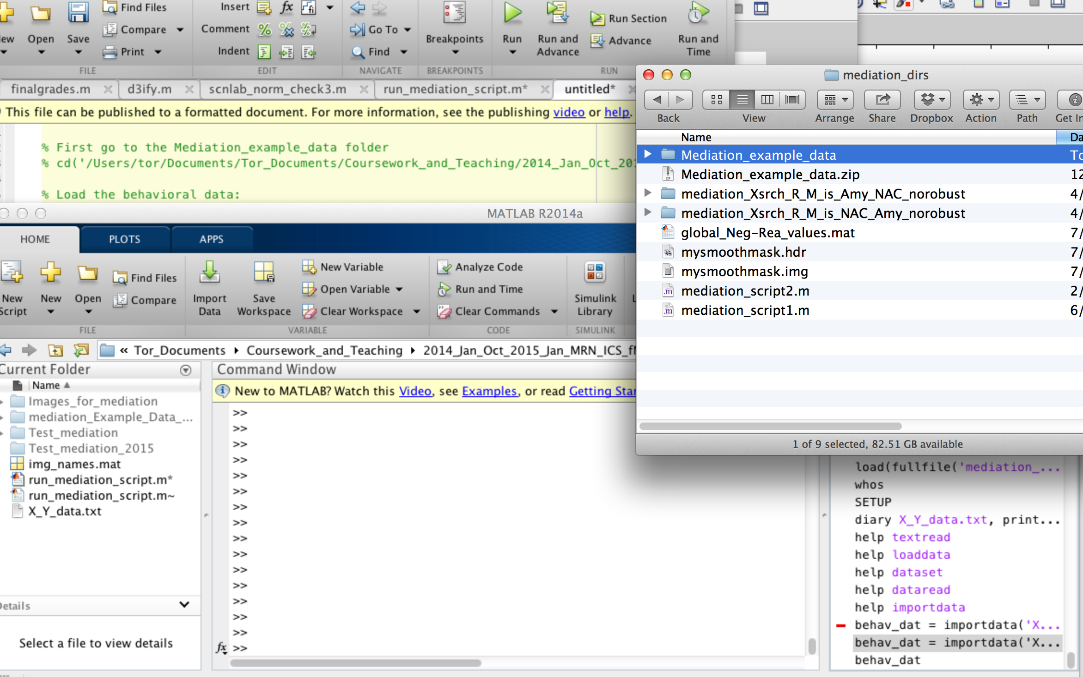
Step 1. Go to sample mediation directory
Drag and drop into command window

Slide 5
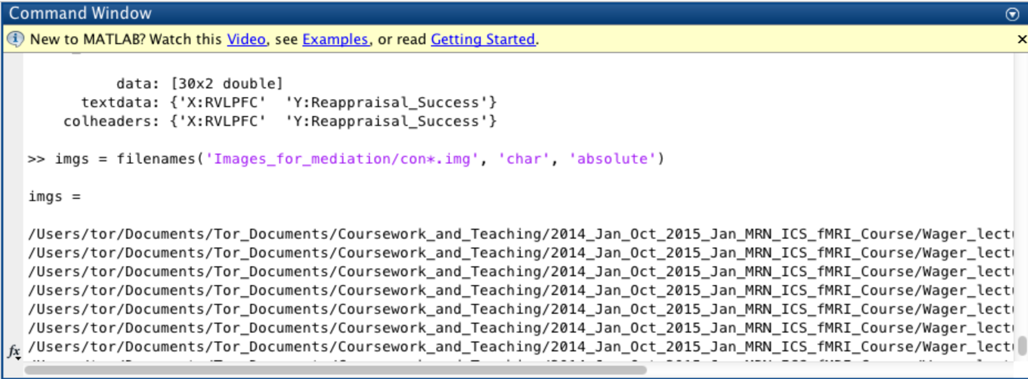
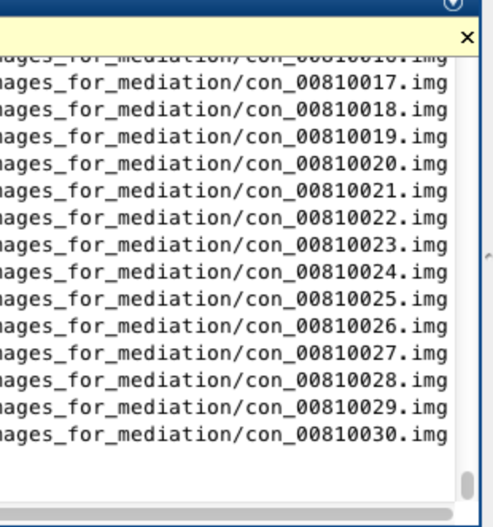
Step 2: List image names
Here I used ‘filenames’ command, available in CANlab core tools. May need other methods depending on operating system.
Character array of names are stored in ‘imgs’ variable.

Slide 6
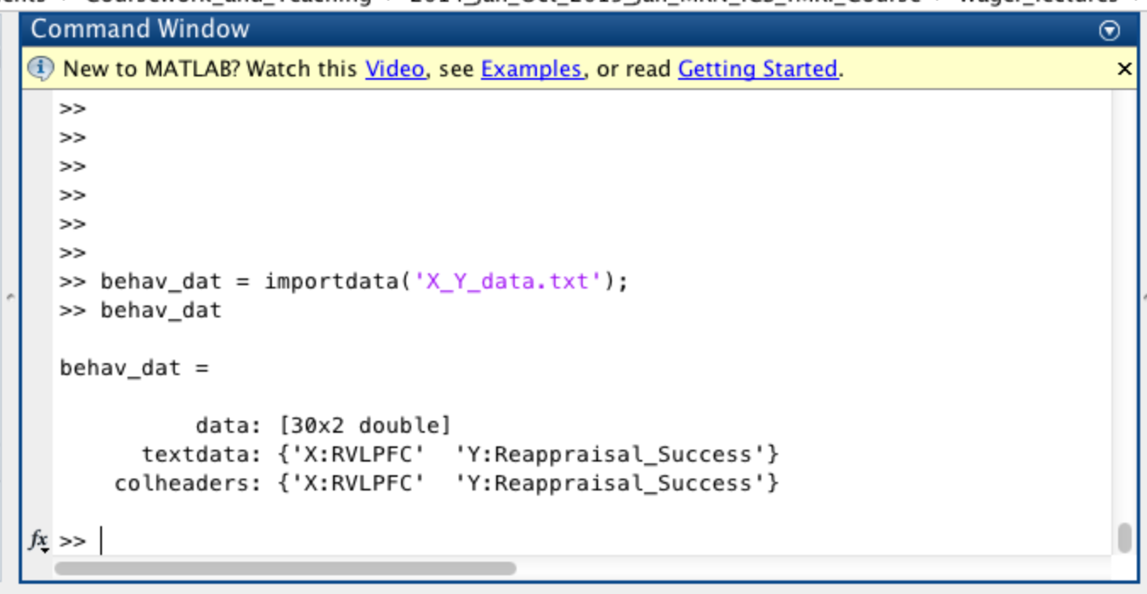
Step 3: Import behavioral data from text file
These are vectors of numbers, one per subject, in the same order as the image files we just loaded
They are saved in the file ‘X_Y_data.txt’ in the mediation test data folder

Slide 7
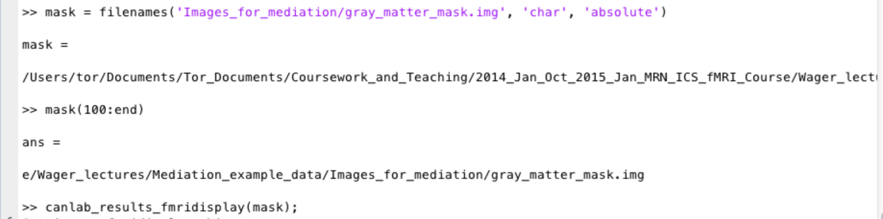
Step 4: Specify mask filename and visually check mask
We will load a canonical gray matter mask, and save the name in the variable ‘mask’
This specifies the voxels that will be analyzed in the mediation analysis
canlab_results_fmridisplay.m in CANlab core tools is used to visually display the mask. You can use other programs as well.

Slide 8
Step 5: Make and go to the results directory
Pre-calculated results are saved in this folder:
mediation_Example_Data_Wager2008_Msearch_R_XisRIFGstim_norobust

Slide 9
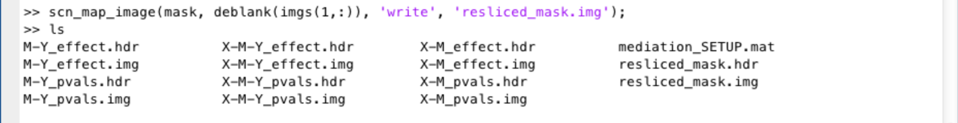
Step 6: Resample the mask
Resample the mask to the space of the functional images (may be required if spaces do not match)
I used ‘scn_map_image.m’ in CANlab core tools
Creates this resampled mask image

Slide 10
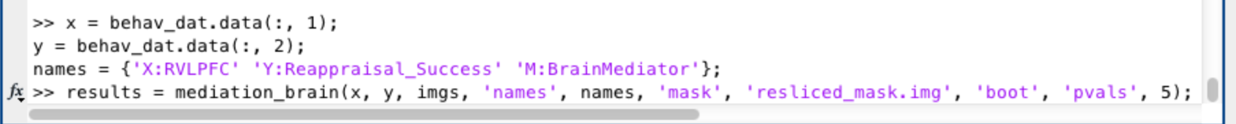
Step 7: Run the mediation
The code below defines x and y variables (VLPFC seed contrast values and Reappraisal Success values, respectively, in this dataset) and variable names
The last line runs the mediation with bootstrapped P-values
Here we are entering image names as the mediator, so we will test the mediation with brain data as the mediator (M) at each voxel.
It is also possible to enter imaging data as the X or Y variable.

Slide 11
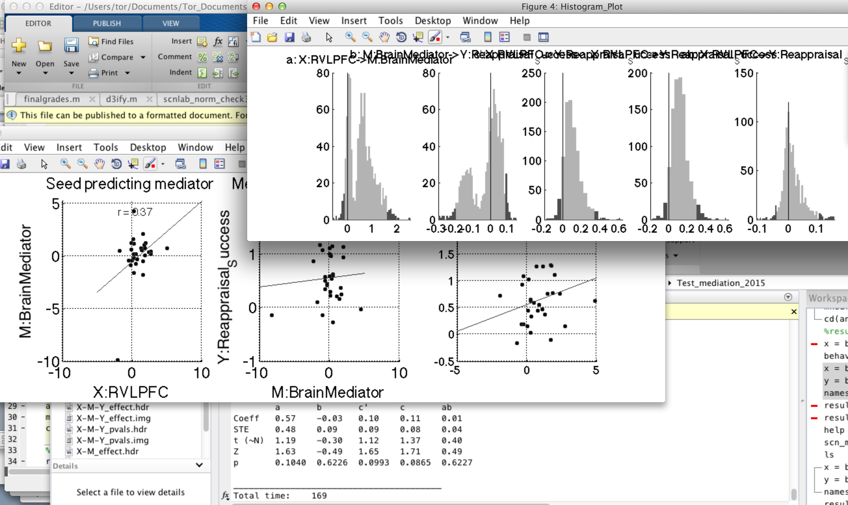
Step 8: Wait for mediation to finish
Scatterplots and bootstrapped histograms are shown for the first voxel in each slice.
The program will stop when all results over the brain have been run
Output is saved in the current (i.e., results) directory in the form of images and a mediation_SETUP.mat file with information about the input variables and options selected.

Slide 12
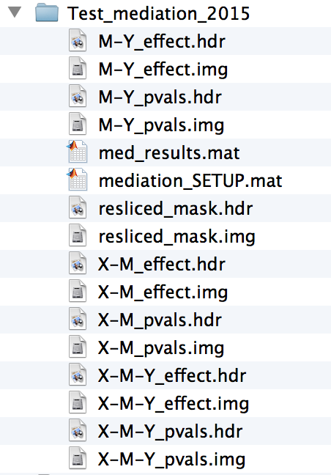
Step 9: Get results
There are many options for getting result maps, tables, extracted data from significant clusters, etc. There is also a batch script to generate and save sets of results montages, tables, etc.
The main functions are mediation_brain_results.m and mediation_brain_results_full_script.m
Images before results scripts are run:
Effect magnitude images for Path a (X-M), Path b (M-Y), and a*b mediation (X-M-Y)
P-value images for Path a (X-M), Path b (M-Y), and a*b mediation (X-M-Y)
Mediation_SETUP.mat : input options and values

Slide 13
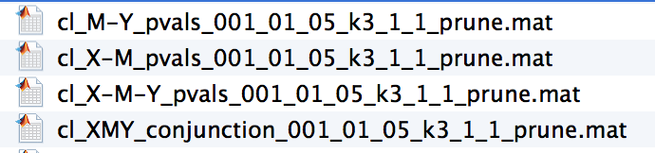
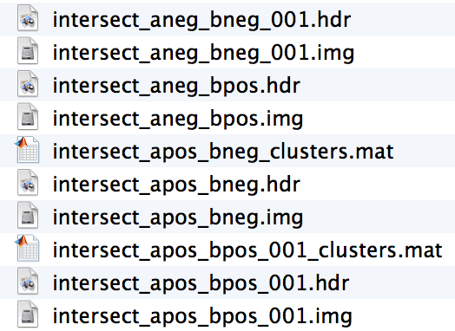
Step 9: Get results
There are many options for getting result maps, tables, extracted data from significant clusters, etc. There is also a batch script to generate and save sets of results montages, tables, etc.
The main functions are mediation_brain_results.m and mediation_brain_results_full_script.m
Images created when results scripts are run:
‘Clusters’ file with significant blobs, coordinates, etc.
Extracted data for averages for each region
Can plot/re-run mediation.m on ROI data (good for display; note circularity issues)
Conjunction images for significant path a and b effects
These can help with interpretation.
- For positively signed ‘path c’ effect, mediators should have either a pos and b pos or a neg and b neg (a*b is positive)
- For negatively signed mediators, a*b should be negative

Slide 14
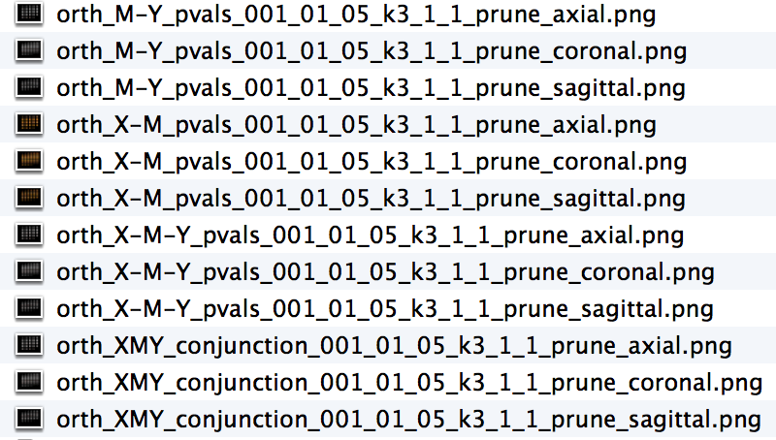
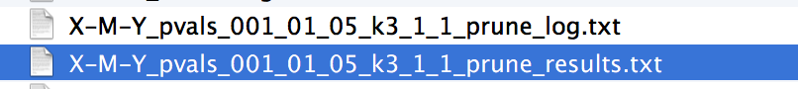
Step 9: Get results
There are many options for getting result maps, tables, extracted data from significant clusters, etc. There is also a batch script to generate and save sets of results montages, tables, etc.
The main functions are mediation_brain_results.m and mediation_brain_results_all_script.m
Images created when results scripts are run:
Images of montages of significant regions for each path
Tables of significant results for each path

Slide 15
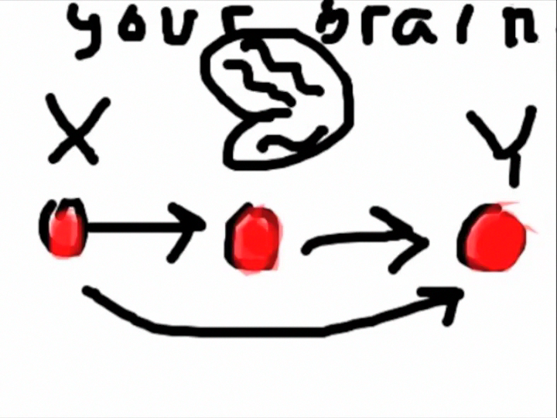
Step 9b: Batch results
The movie below shows you several major options

